Slide 1
Simple Crosswords

Slide 2
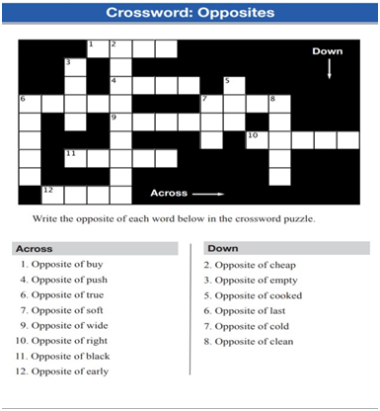
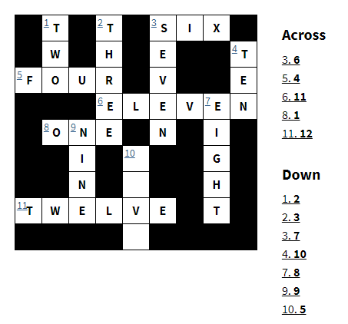
Write Numbers 1 - 12

Slide 3
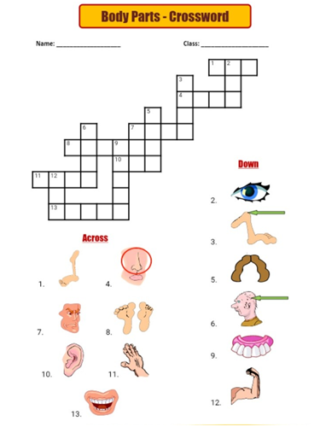
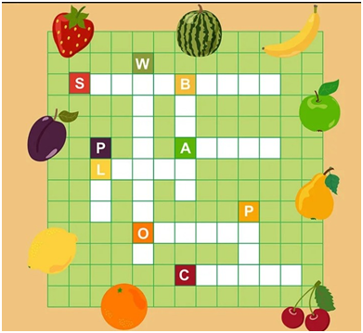

Slide 4
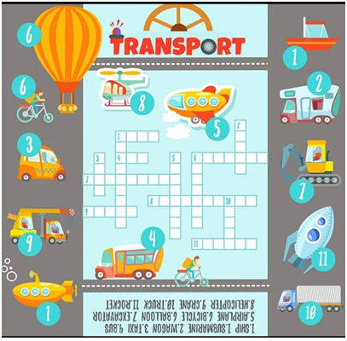
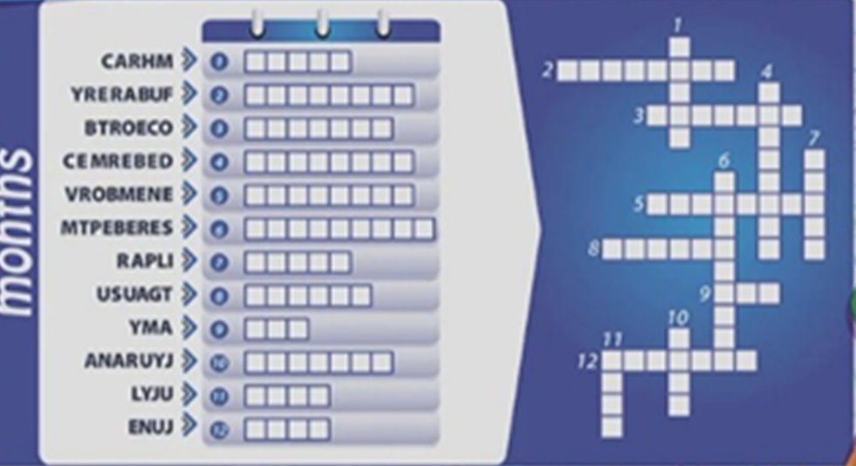

Slide 5
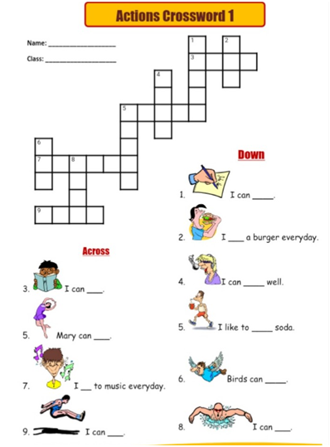
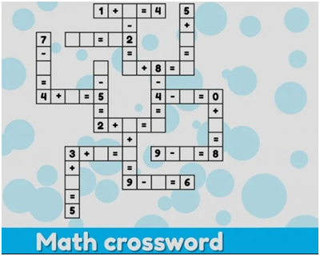

Slide 6
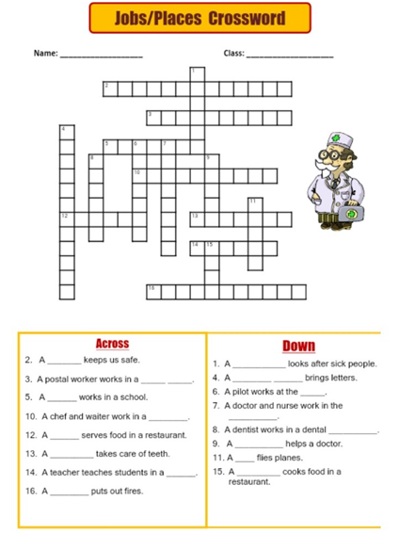
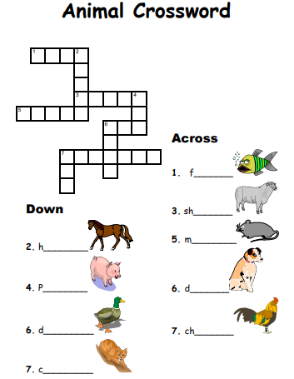

Slide 7
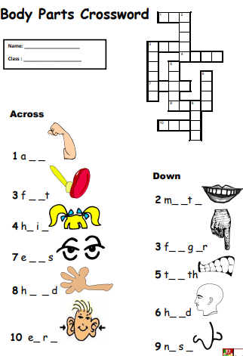
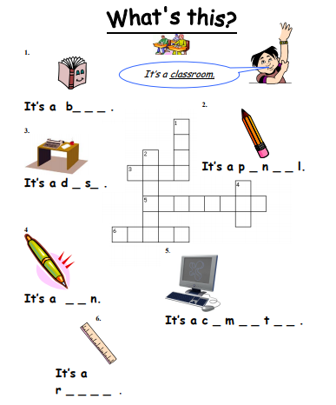

Slide 8
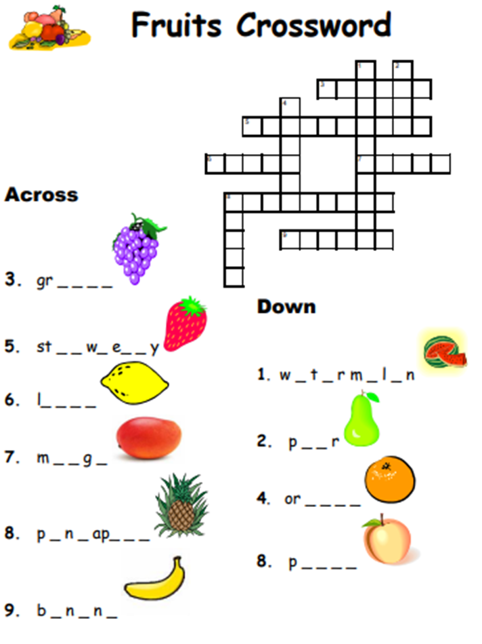
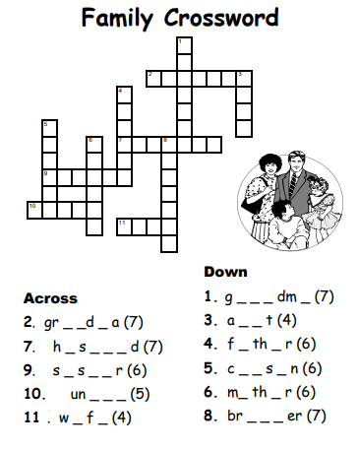

Slide 9
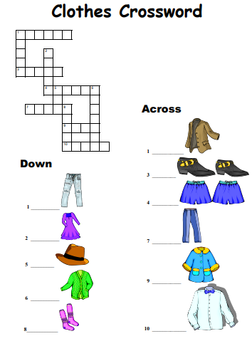
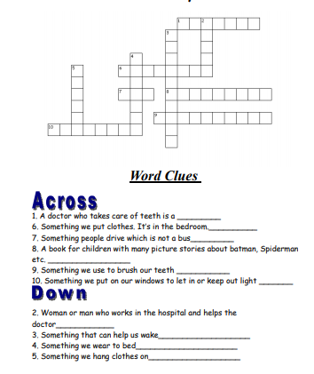

Slide 10
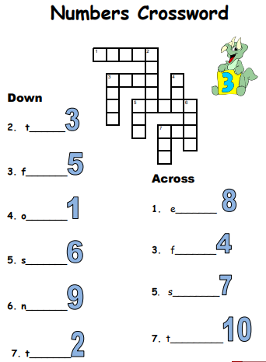
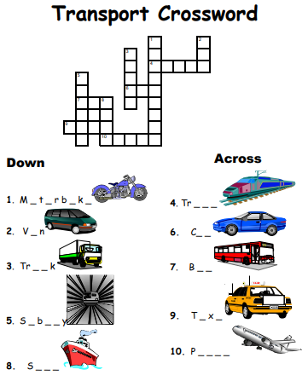

Slide 11
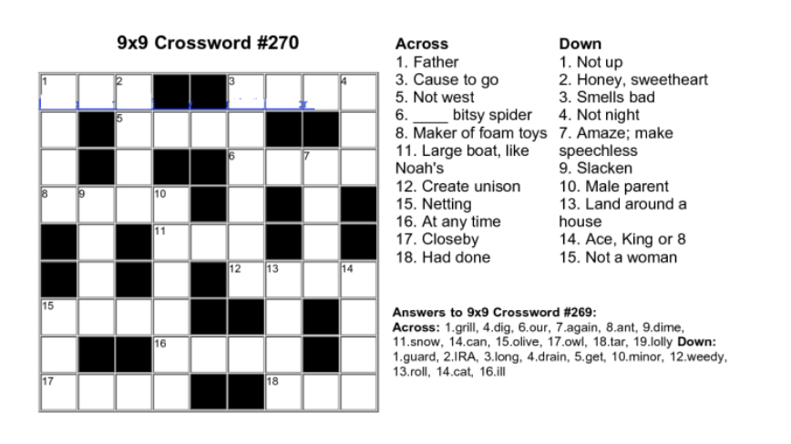

Slide 12
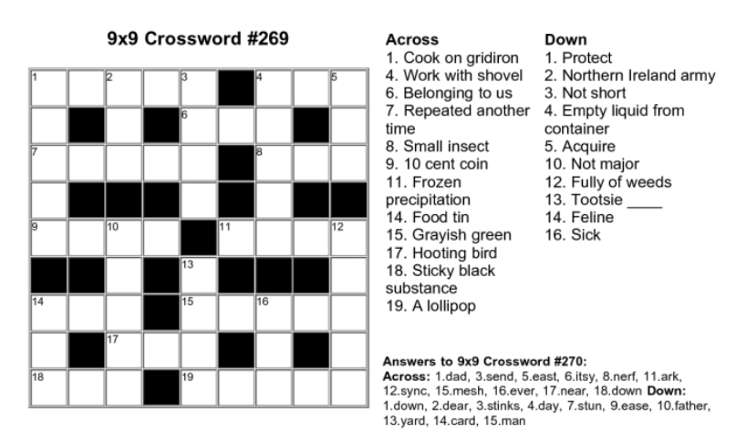

Slide 13
Match the Following

Slide 14
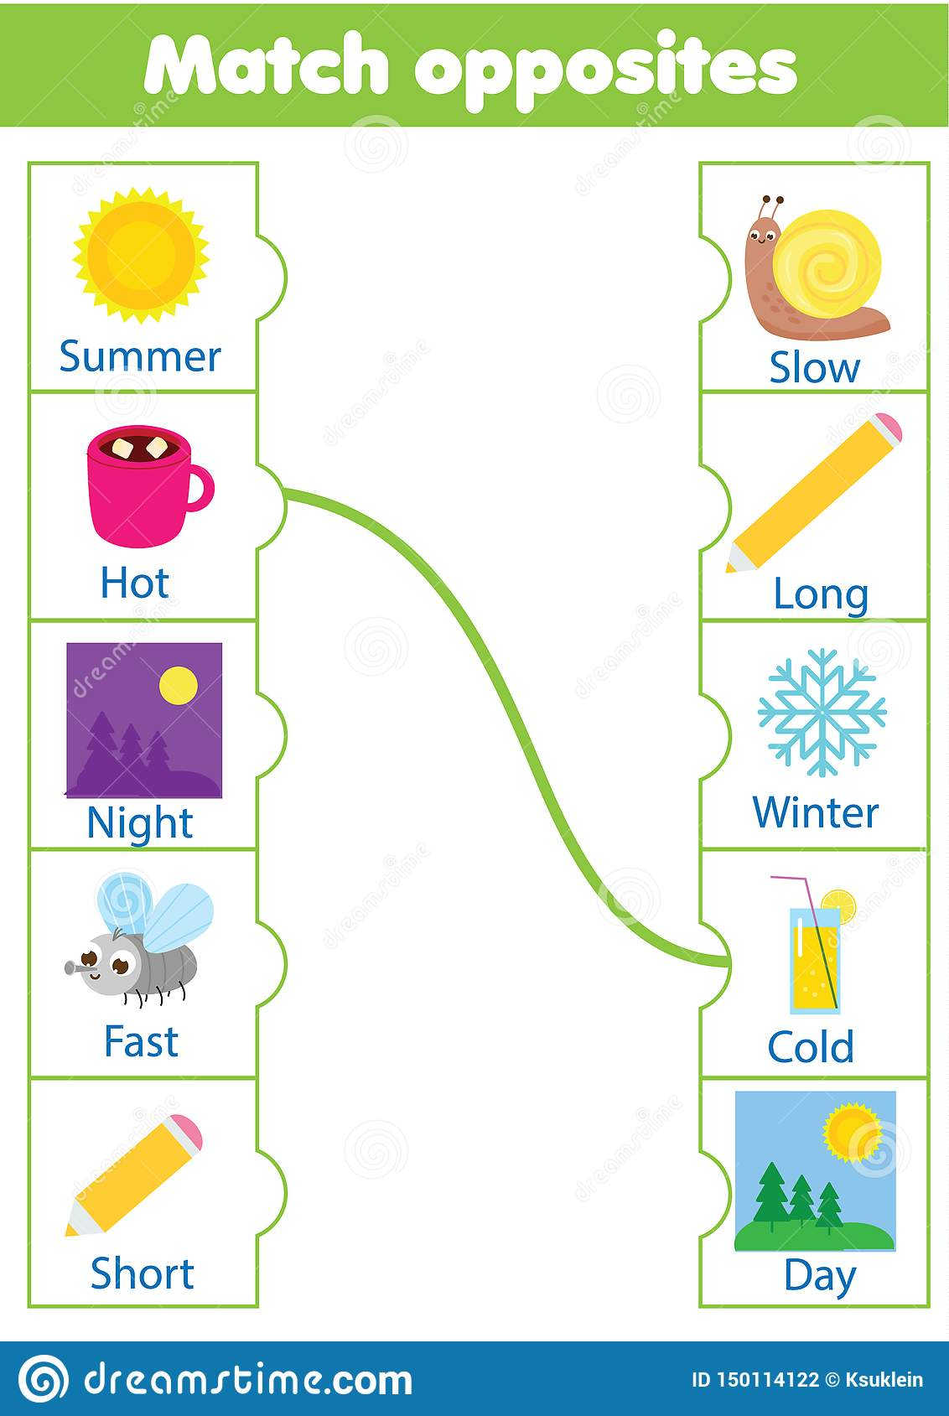
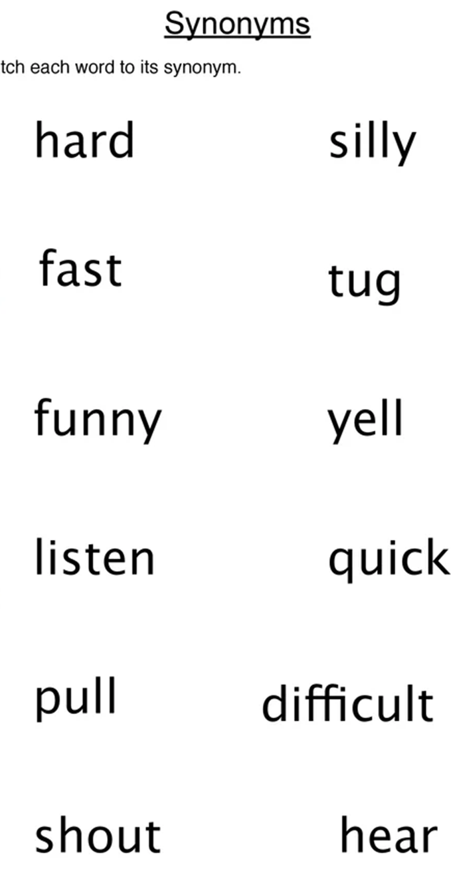
Level 2
Level 1

Slide 15
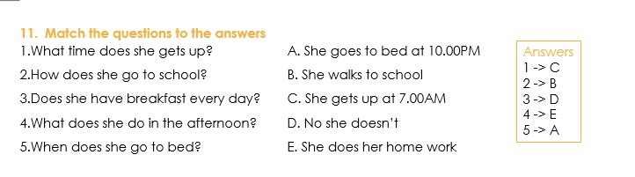
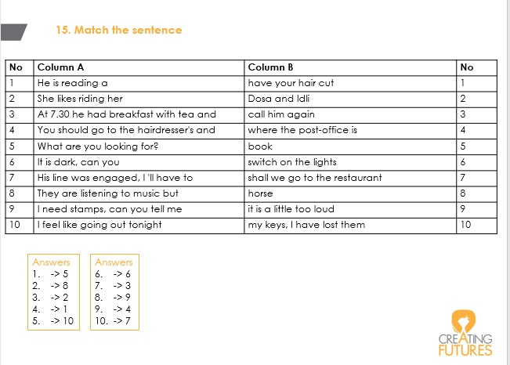
Level 3
Level 4

Slide 16
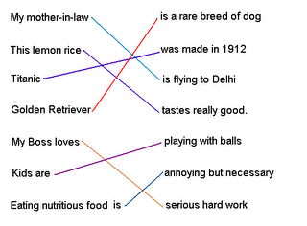
Level 5
Answers
(i) a quarrel or an argument | 1. slaving
(ii) remove something from inside another thing using a sharp tool | 2. chaos
(iii) strange, mysterious, difficult to explain | 3. rummage
(iv) finish successfully, achieve | 4. scrape out
(v) search for something by moving things around hurriedly or carelessly | 5. stumble over, tumble into
(vi) complete confusion and disorder | 6. accomplish
(vii) fall, or step awkwardly while walking | 7. uncanny
(viii) working hard | 8. (to have or get into) a row
Slaving = > (viii) working hard.
Chaos => (vi) complete confusion and disorder.
rummage => (v) search for something by moving things around hurriedly or carelessly.
scrape out => (ii) remove something from inside another thing using a sharp tool.
stumble over, tumble into => (vii) fall, or step awkwardly while walking.
accomplish => (iv) finish successfully, achieve.
uncanny => (iii) strange, mysterious, difficult to explain.
(to have or get into) a row => (i) a quarrel or an argument.
Level 6

Slide 17
Word Search

Slide 18
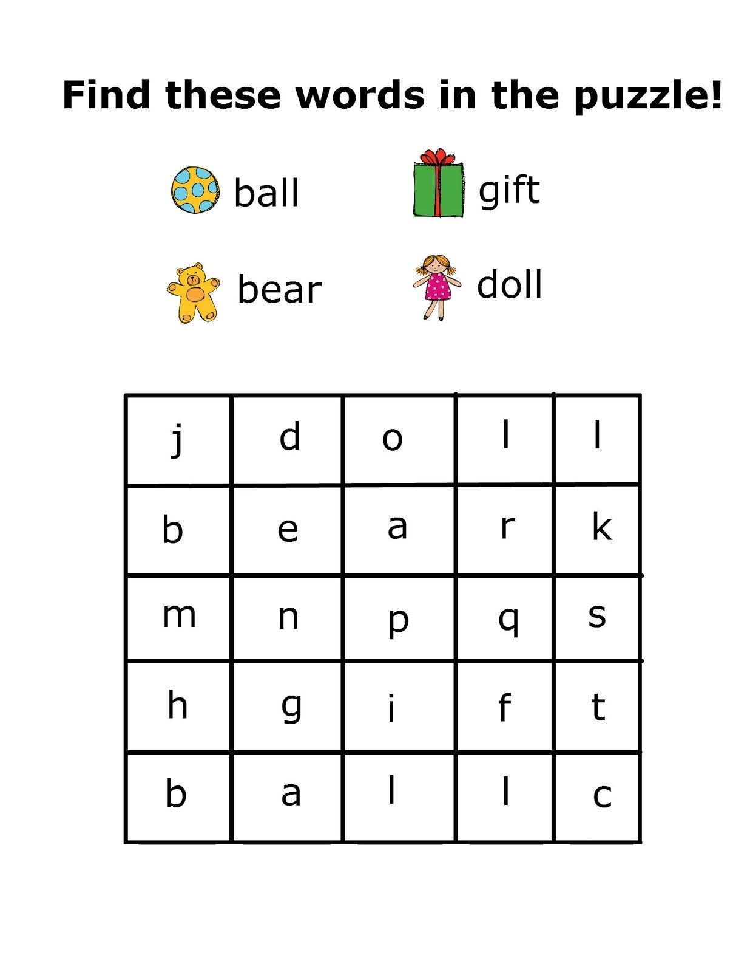
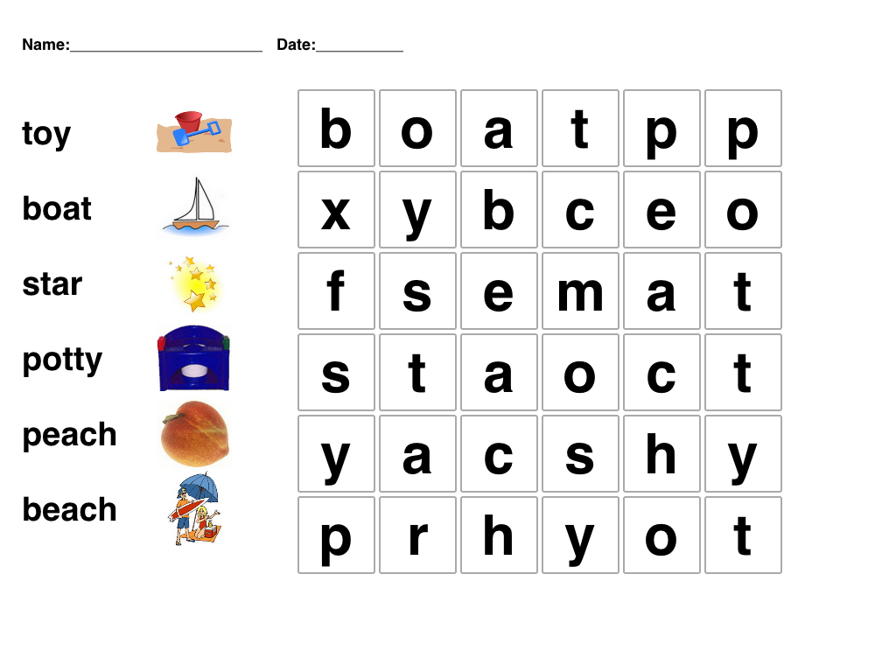
LEVEL 1
LEVEL 2

Slide 19
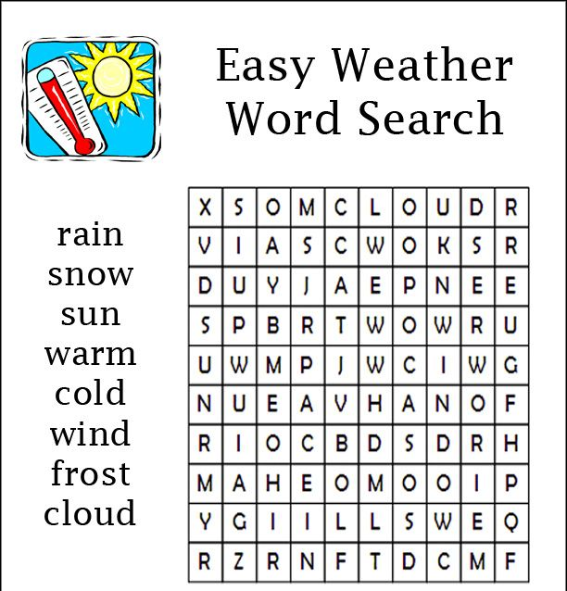
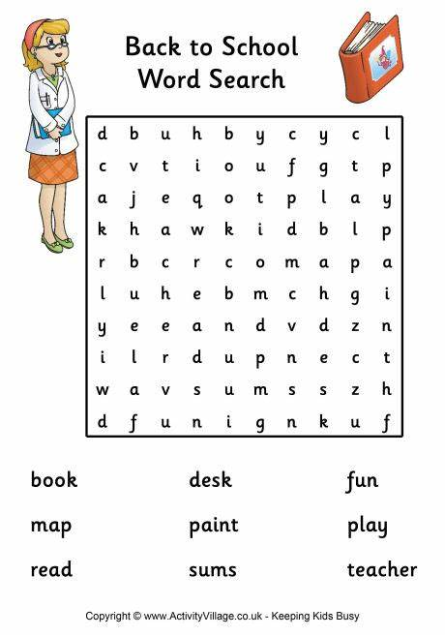
LEVEL 3
LEVEL 4

Slide 20
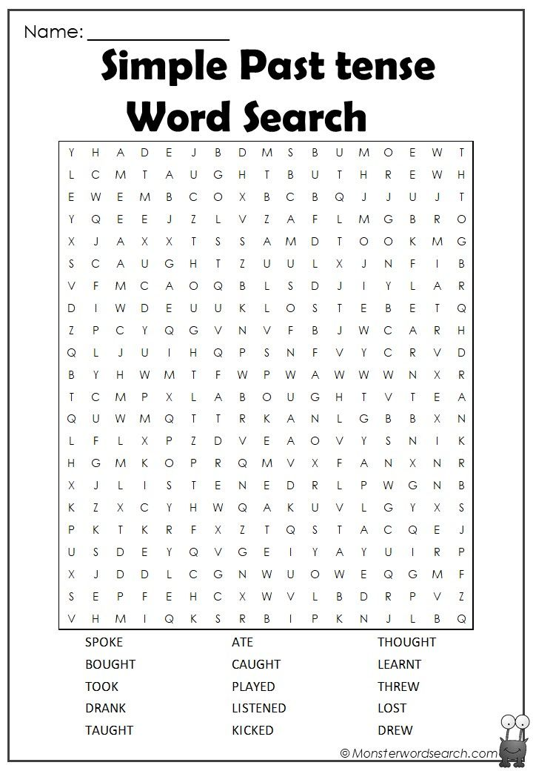
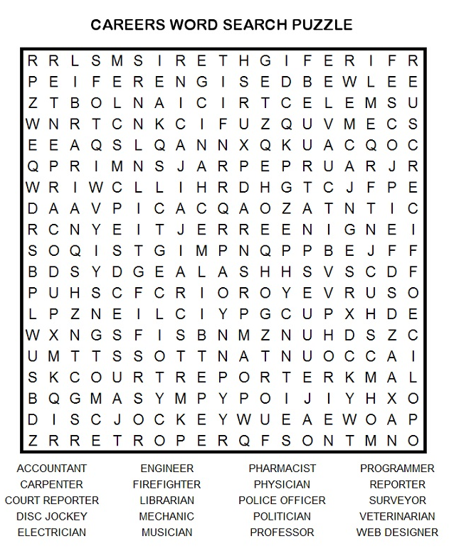
LEVEL 6
LEVEL 5

